Slide 1
Reflected XSS Report – testasp.vulnweb.com
Vulnerability Type: Reflected Cross-Site Scripting (XSS)
Target Endpoint: /search.asp
Author: Mayur
Tool Used: Burp Suite
Date of Discovery: 17-07-2025

Slide 2
Summary
A reflected Cross-Site Scripting (XSS) vulnerability exists in
search.asp on testasp.vulnweb.com.
The server reflects unescaped user input from the
search query parameter directly into the HTML response..
Exploitation allows the execution of arbitrary JavaScript in the victim’s browser.
Confirmed using and alternate payloads via Burp Suite.
"This vulnerability enables attackers to run malicious scripts, compromising user trust and browser integrity."

Slide 3
Methodology
Tools Used
Burp Suite (Proxy, Repeater)
Browser Developer Tools
Screen recording software for video evidence

Slide 4
Approach
Intercepted traffic to
search.asp using Burp Proxy
Modified the
search query parameter with XSS payloads:
Sent the modified request via Burp Repeater
Observed unsanitized reflection in HTML response
Confirmed alert execution in browser

Slide 5
Test validation
Payload successfully echoed in raw response
Executed upon page load, proving script injection
DOM inspection confirmed presence of <script> tag
"This step validates that user input directly controls executable content in the rendered page — a textbook reflected XSS pattern."

Slide 6
Reproduction Steps
🔗 Step-by-Step Execution
Launch Burp Suite
Set up proxy listener on 127.0.0.1:8080
Configure browser to route through Burp
Intercept Request
Visit:
http://testasp.vulnweb.com/search.asp?search=hello
Burp captures the HTTP GET request to search.asp
Send to Repeater
Replace search=hello with:
<script>alert('XSS')</script>
Click Send and check the Response tab
Validate Reflection
Observe unsanitized payload in the raw HTML response
Confirm presence of <script> tag

Slide 7
5.Execute in Browser
Paste the payloaded URL directly in browser
Confirm alert('XSS') popup executes
Inspect DOM with DevTools to verify payload injection

Slide 8
Titles and Proofs
Payloads Used
<script>alert('XSS')</script>
Proof of Execution
Payload inserted into
search.asp?search=………
HTML response displayed the payload unsanitized
JavaScript executed on page load → triggered alert box
Browser DevTools revealed raw <script> tag in the DOM

Slide 9
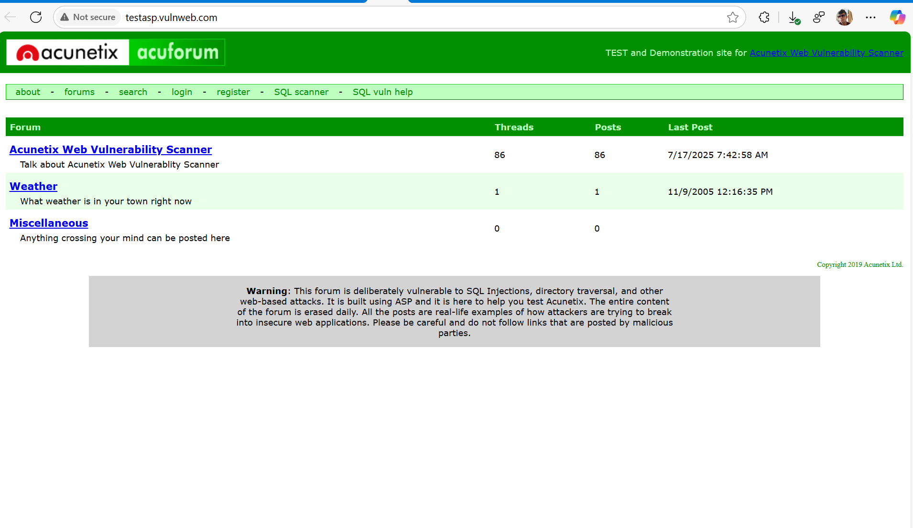

Slide 10
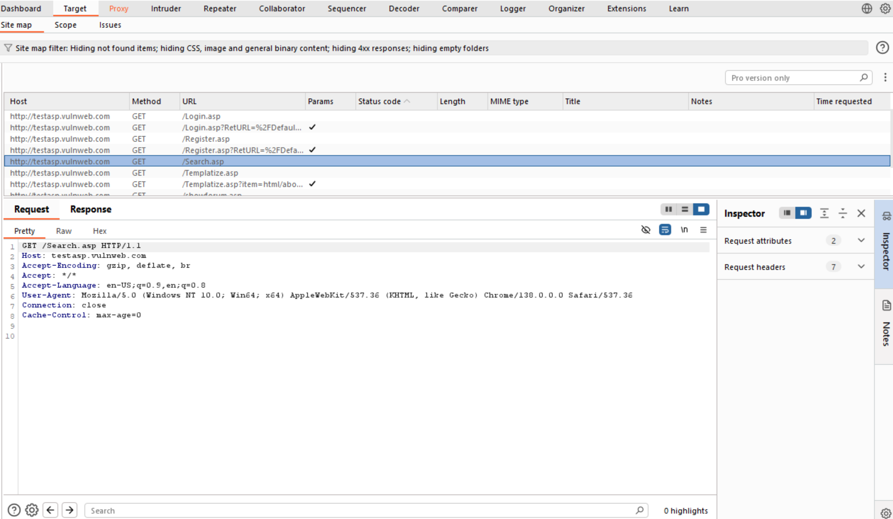

Slide 11
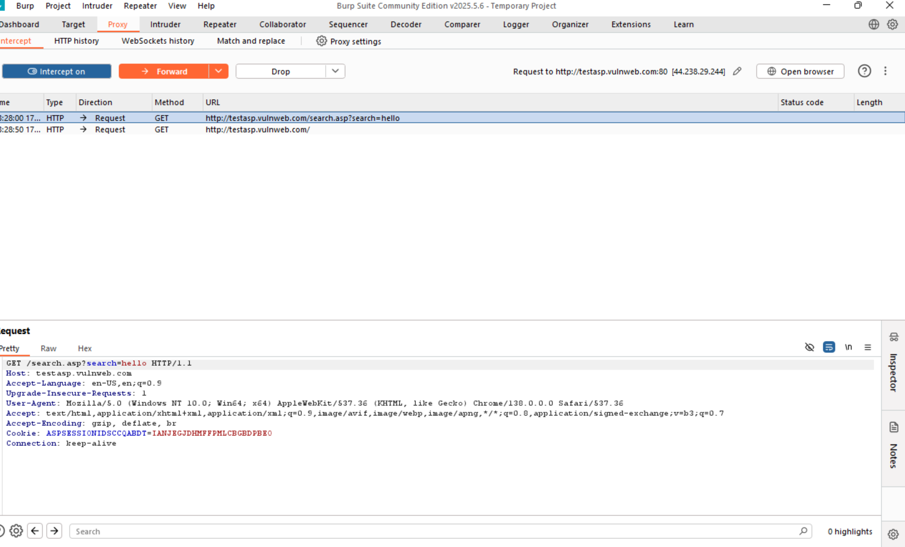

Slide 12
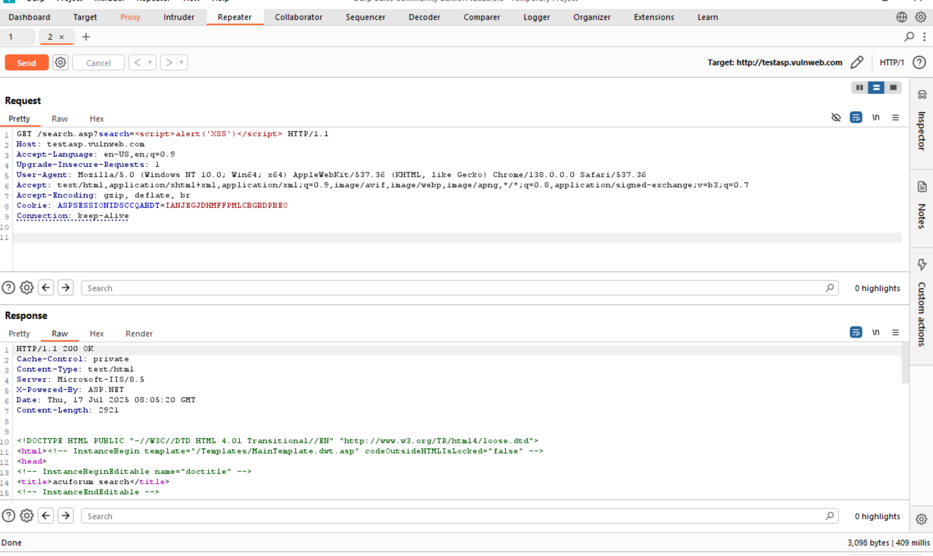

Slide 13
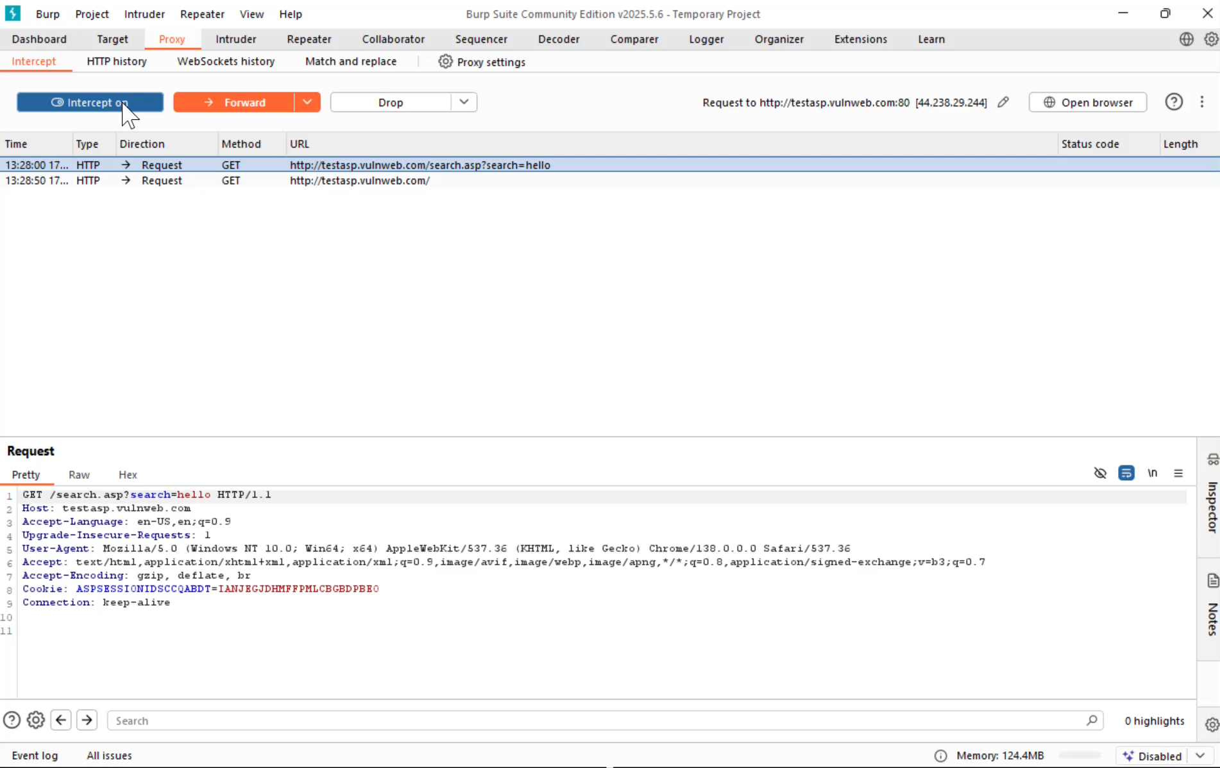

Slide 14
Impact of Reflected XSS
What Can an Attacker Do?
Session Hijacking Steal cookies or session tokens via document.cookie
Phishing Attacks Inject malicious links, fake login forms, or redirection scripts
Malware Delivery Embed scripts that load external malware or spyware
User Trust Violation Manipulate UI elements or inject misleading content

Slide 15
Risk to Stakeholders
Users: Compromised browser security, loss of sensitive data
Site Owner: Reputation damage, legal liability, user attrition
Platform Ecosystem: Breaks origin trust, threatens other integrated services
A simple reflected script could be the entry point for full client-side compromise — XSS is small in code, big in consequence.

Slide 16
Recommended Mitigations
Immediate Fixes
HTML Output Encoding Use <, >, ", etc. to prevent script execution
Input Validation Reject unexpected characters in query parameters (<, >, ', ")
Secure Templating Engines Adopt frameworks (e.g., React, Django templates) that auto-escape content

Slide 17
Defense-in-Depth
Content Security Policy (CSP)
Restrict inline scripts and limit external sources with headers like:
Content-Security-Policy: script-src 'self’;
HTTPOnly & SameSite Cookies Prevent session theft via JavaScript access or CSRF leaks
Security Audits & Testing Regular automated scans + manual reviews of input-handling logic

Slide 18
Conclusion
Final Verdict
Reflected XSS vulnerability confirmed on search.asp at testasp.vulnweb.com
Payloads successfully injected and executed via unsanitized search parameter
Burp Suite and browser tests validate exploitability
Risk includes session theft, phishing, and user compromise
Key Takeaways
Always encode and sanitize user input when rendering dynamic HTML
Simple input reflections can escalate into serious client-side threats
Developers should implement CSP and output encoding proactively
Security audits must include both server- and client-side input handling
“This report demonstrates the critical nature of reflected XSS and offers a roadmap for
identifying and remediating similar vulnerabilities across web applications.”

